Slide 1
Notes:
Recommended to watch for this presentation: KEY01 - https://mybuild.microsoft.com/en-US/sessions/68db9504-7c75-4a73-8562-dbbd669a3e1f
Hello and welcome to this special hybrid Microsoft Build 2022 event, looking at the top announcements and news for developers across Australia and New Zealand.

Slide 2
What can we build?
Notes:
The last few years have highlighted some of the enormous challenges we face but have also shown us how technology and developers can help the world through these challenges.
In his opening keynote for Microsoft Build, Microsoft Chairman and CEO, Satya Nadella talked about the opportunity in front of developers and the two questions they need to ask:
What can we build?

Slide 3
What does the world need us to build?
What can we build?
Notes:
And more importantly what does the world need us to build?

Slide 4
What does the world need?
Notes:
The challenges may be many, but developers can harness their expertise and contribute massively to the world around them.
Let those two inspiring questions sit with you for a minute, and let’s lighten the mood a little.
We thought we’d take some of the challenges the world is facing and combine them with some cool tech hosted on Azure – Dall-E from OpenAI.

Slide 5
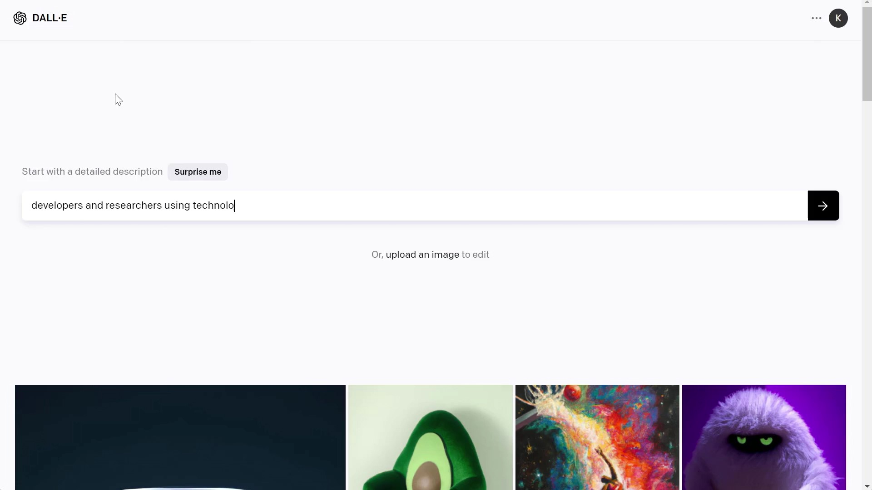
Notes:
Demo Video: 01-01 Dall-E.mp4
Dall-E is a neural network trained on Azure by our partner OpenAI. We thought we’d ask Dall-E to generate images based on our description of some of the challenges that developers can help the world solve.
The resulting images have been created purely based on that text description we provided of "developers and researchers using technology to address sustainabilty, inflation and recession, digital art" provided. Cool hey?
While it’s not part of today’s event, we are announcing a limited preview of the Azure OpenAI Service that provides on-demand access to the advanced coding and natural language capabilities being built by OpenAI.
[HOW?]

Slide 6
Microsoft Build 2022 key themes
Rapidly code, test, and ship from secure cloud developer environments
Scale cloud-native apps and accelerate app modernisation
Accelerate innovation and achieve agility with a trusted, integrated data platform with hybrid and multi cloud capabilities
Create next-gen experiences at scale with Windows: an open platform, an open store, and home to over 1B devices
Innovate with collaborative apps and low code
Source: https://mybuild.microsoft.com/home
Notes:
From the first days of MS-DOS, Microsoft has been a platform and tools company – built by developers for developers.
Microsoft Build takes these roots and delivers tools and services to support today's developer, building any app, on any device, for any platform.
Today's developer challenges include speed, security, scale and innovation across cloud native apps, app modernisation, data platforms and low code environments. The opportunities are there if we can just make your day better and reduce some of the friction you experience when you're just trying to stay in the flow of your work.
At today’s event we will be focusing on three of these themes [ next slide ]

Slide 7
Microsoft Build 2022 key themes
Rapidly code, test, and ship from secure cloud developer environments
Scale cloud-native apps and accelerate app modernisation
Accelerate innovation and achieve agility with a trusted, integrated data platform with hybrid and multi cloud capabilities
Create next-gen experiences at scale with Windows: an open platform, an open store, and home to over 1B devices
Innovate with collaborative apps and low code
Source: https://mybuild.microsoft.com/home
Notes:
At today’s event we will be focusing on just three of these themes.
- Rapidly code, test and ship from secure cloud developer environments.
Scale cloud-native apps and accelerate app modernisation
Innovate with collaborative apps and low code
Alright, now we know where we’re headed, let’s see who will be guiding us on this journey today.

Slide 8
Agenda
01
03
Scale cloud-native apps and accelerate app modernisation Speaker
Innovate with collaborative apps and low code Speaker
02
Rapidly code, test, and ship from secure cloud developer environments Speaker

Slide 9
MC’s highlight
Stick around!
Notes:
Now we promised you 10 things for every developer.
If you pay attention to the rest of our speakers, you’ll notice we’ll cover 9 of those things, so make sure you stick around until the end of the event where I’ll give you my 1 highlight from Build!

Slide 10
Notes:
It's my pleasure to hand you over to Jorge Arteiro and Scott Coulton … [intro blurb]

Slide 11
Show happens

